Slide 1

Project Name – Book Shop
NATIONAL INSTITUTE OF TECHNOLOGY
JAMSHEDPUR
SECOND SEMESTER PROJECT
Team Member – SHADAB HUSSAIN
AMAN AGRAHARI
ARPIT PANDEY
Faculty in charge – DR. ALEKHA KUMAR MISHRA

Slide 2
INTRODUCTION
Every book shop, big or small, has challenges to manage the information of books. This application software have been developed by us to overcome the problem of manual record maintenance system.
OBJECTIVE
The objective of developing this software is that administrator will be able to maintain the record of books digitally. With the implementation of computerized system, the task of keeping records in an organized manner and retrieval of information will be solved.

Slide 3
MODULES
Add Book-
Function for adding new book in records.
Show book-
Function for displaying record of books.
Check availability-
Function for checking book is present or not.
Update Book-
Function for updating book.
Sell book-
Function for deleting copy of book.

Slide 4
Implementation
//Start of bookshop.cpp file
#include<bits/stdc++.h>
#include<fstream>
#include<conio.h>
#include<cassert>
#include "bookshopclass.h"
using namespace std;
int main()
{
system("color 0A");
BookShop B;
int choice;
char x='n';
while (1)
{
B.control_panel();

Slide 5
Continue….
cout << "\n\nEnter your choice : ";
cin >> choice;
switch (choice) {
case 1:{
do {
B.add_book();
cout << "\n\nWant to add another book? (y/n) : ";
cin >> x;
} while (x == 'y');
break;
}
case 2:
B.show_book();
break;

Slide 6
Continue….
case 3:
B.check_availability();
break;
case 4:
B.update_book();
break;
case 5:
B.sell_book();
break;
case 6:
exit(0);
break;
default:
cout << "\n\nINVALID CHOICE\n";
}
getch();
}
return 0;
}// End of bookshop.cpp file which include the header file bookshopclass.h

Slide 7
// start of content in header file bookshopclass
#include<bits/stdc++.h>
#include<fstream>
#include<cassert>
using namespace std;
//function for printing = symbol
void design(short size,char symbol)
{
for(short i=0;i<size;i++)
cout << symbol;
}

Slide 8
//class for bookshop
class BookShop
{
int BookID,NoOfCopy;
string BookName,AuthorName;
float price_per_book;
public:
void control_panel();
void add_book();
void show_book();
void check_availability();
void update_book();
void sell_book();
};

Slide 9
//function for displaying MENU of book shop
void BookShop::control_panel()
{
system("CLS");
design(120,'=');
cout << "\n\n\t\t\t ######################## CONTROL PANEL ######################## \n";
design(120,'_');
cout << endl << endl;
cout << "\n\t Enter 1 for add book ";
cout << "\n\t Enter 2 for show book ";
cout << "\n\t Enter 3 for check Availability ";
cout << "\n\t Enter 4 for update book ";
cout << "\n\t Enter 5 to Sell book ";
cout << "\n\t Enter 6 to exit";
cout << endl;
design(120,'=');
return ;
}

Slide 10
//function for adding new book in records
void BookShop::add_book()
{
system("CLS");
design(120,'=');
cout << endl << endl;
cout << "\t\t\t ######################## Add Only New Books in Shop
########################\n";
design(120,'_');
cout << "\n\n";
cout << "\n\t Enter Book ID : ";
cin >> BookID;
cout << "\n\t Enter Book Name : ";
getline(cin>>ws,BookName);
cout << "\n\t Enter Author Name : ";
getline(cin>>ws,AuthorName);
cout << "\n\t Enter No Of It's Copies : ";
cin >> NoOfCopy;

Slide 11
Continue….
cout << "\n\t Enter Price per Book : ";
cin >> price_per_book;
ofstream fout("BookData.txt",ios::out | ios::app);
if(fout.is_open())
{
fout << BookID<<"\n" << BookName << "\n" << AuthorName << "\n" << NoOfCopy << "\n"
<< price_per_book << "\n\n";
cout << "\n\t _ Books are added in shop _\n";
}
else{
cout << "\n\t _ Error in opening file __ \n";
}
fout.close();
cout<<"\n";
design(120,'=');
return ;
}

Slide 12
//function for displaying record of books
void BookShop::show_book()
{
system("CLS");
design(120,'=');
cout << "\n\n";
cout << "\t\t\t ######################## Show All Books of Shop
########################\n";
design(120,'_');
cout << endl << endl;
ifstream fin("BookData.txt",ios::in);
if(fin.is_open()){
cout << "\n\n"<<setw(15) << "Book ID" << setw(25) << "Book Name"<<setw(25)
<<"Author Name"<<setw(15) << "NoOfCopies" << setw(20) << "price per book"<< "\n\n";
fin >> BookID;
getline(fin>>ws,BookName);
getline(fin>>ws,AuthorName);
fin>>NoOfCopy;
fin>>price_per_book;

Slide 13
Continue….
while(!fin.eof())
{
cout<<setw(15)<<BookID<<setw(25)<<BookName<<setw(25)<<AuthorName
<<setw(15)<<NoOfCopy<<setw(15)<<price_per_book<<"\n";
fin>>BookID;
getline(fin>>ws,BookName);
getline(fin>>ws,AuthorName);
fin >> NoOfCopy;
fin >> price_per_book;
}
cout << "\n";
design(120,'=');
system("pause");
}
else{
cout << "\n\t _ Error in File Opening _\n";}
fin.close();
return ;
}

Slide 14
//function for checking book present or not
void BookShop::check_availability()
{
system("CLS");
design(120,'=');
cout << "\n\n \t\t\t ######################## Check Book #################
####### \n";
design(120,'_');
cout << "\n\n";
int flag=0;
int Bid;
cout << "\n Enter Book Id to search ";
cin >> Bid;
ifstream fin("BookData.txt",ios::in);
if(fin.is_open()){
fin >> BookID;
getline(fin>>ws,BookName);

Slide 15
Continue….
getline(fin>>ws,AuthorName);
fin >> NoOfCopy;
fin >> price_per_book;
while(!fin.eof())
{
if(Bid==BookID)
{
cout << "\n\n"<<setw(15) << "Book ID"<<setw(25) << "Book Name"<<setw(25)
<< "Author Name"<<setw(15) << "NoOfCopies"<< setw(25) << "price per book "
<< "\n\n";
cout << setw(15) << BookID << setw(25) << BookName << setw(25) << AuthorName
<< setw(15) << NoOfCopy << setw(15) << price_per_book << "\n";
flag=1;
break;
}
fin >> BookID;
getline(fin>>ws,BookName);
getline(fin>>ws,AuthorName);

Slide 16
Continue….
fin >> NoOfCopy;
fin >> price_per_book;
}
if(flag==0)
{ cout << "\n\t _ Book Is Not Available __\n";}
}
else{
cout << "\n\t _ Error in File Opening ___\n";
}
cout << endl;
design(120,'=');
fin.close();
return ;
}

Slide 17
//function for deleting copy of book
void BookShop::sell_book()
{
int ct=0;
int Bid;
int no;
system("CLS");
design(120,'=');
cout << "\n";
cout << "\n \t\t\t ######################## Delete Book ######################## \n";
design(120,'_');
cout << endl;
cout << "\n Enter Book Id that has to be purchased ";
cin >> Bid;
cout << "\n Enter no of copies you wanna purchase ";
cin >> no;
ifstream fin("BookData.txt",ios::in);
ofstream fout("BookData1.txt",ios::app);

Slide 18
Continue….
if(fin.is_open())
{
fin >> BookID;
getline(fin>>ws,BookName);
getline(fin>>ws,AuthorName);
fin >> NoOfCopy;
fin >> price_per_book;
while(!fin.eof()){
if(BookID==Bid)
{
ct=1;
if(no<NoOfCopy)
{
fout << BookID<<"\n" << BookName << "\n" << AuthorName << "\n" << (NoOfCopy-no ) << "\n"<<price_per_book<<"\n\n";

Slide 19
Continue….
cout<<"\n\t __ Books Are Purchased Successfully __ \n";
}
else if(no>NoOfCopy)
{
fout << BookID << "\n" << BookName << "\n" << AuthorName << "\n" << (NoOfCopy) << "\n" << price_per_book << "\n\n";
cout << "\n\t __ Only " << NoOfCopy << " Books are/is available in shop___ \n";
}
else
{
cout << "\n\t __All the Books of BookID " << BookID << " has been purchased __ \n";
}
}
else
{

Slide 20
Continue….
fout << BookID << "\n" << BookName << "\n" << AuthorName << "\n" << (NoOfCopy) << "\n" << price_per_book << "\n\n";
}
fin >> BookID;
getline(fin>>ws,BookName);
getline(fin>>ws,AuthorName);
fin >> NoOfCopy;
fin >> price_per_book;
}
if(ct==0)
{
cout << "\n\t _ Book Not Available __\n";
}
}
else
{
cout << "\n\t _ Error in File Opening __\n";
}
cout << "\n";

Slide 21
Continue….
design(120,'=');
fout.close();
fin.close();
remove("BookData.txt");
rename("BookData1.txt","BookData.txt");
return ;
}

Slide 22
//function for updating book information in record
void BookShop::update_book()
{
system("CLS");
design(120,'=');
cout << "\n \n\t\t\t ######################## Update Existing Book ########################\n";
design(120,'_');
cout << endl;
int flag=0;
string B_name,A_name;
int Bid,no;
float price;
cout << "\n\t Enter Book ID ";
cin >> Bid;
cout << "\n\t Enter Book Name ";
getline(cin>>ws,B_name);

Slide 23
Continue….
cout << "\n\t Enter Author Name ";
getline(cin>>ws,A_name);
cout << "\n\t Enter No Of It's Copies ";
cin >> no;
cout << "\n\t Enter Price per Book ";
cin >> price;
ifstream fin("BookData.txt",ios::in);
ofstream fout("BookData1.txt",ios::app);
if(fin.is_open())
{
fin>>BookID;
getline(fin>>ws,BookName);
getline(fin>>ws,AuthorName);
fin >> NoOfCopy;
fin >> price_per_book;
while(!fin.eof())
{
if(BookID==Bid)

Slide 24
Continue….
{
fout << Bid << "\n" << B_name << "\n" << A_name << "\n" << no << "\n"
<< price << "\n\n";
flag=1;
}
else
{
fout << BookID << "\n" << BookName << "\n" << AuthorName << "\n" \
<< (NoOfCopy) << "\n" << price_per_book << "\n\n";
}
fin >> BookID;
getline(fin>>ws,BookName);
getline(fin>>ws,AuthorName);
fin >> NoOfCopy;
fin >> price_per_book;
}
if(flag==0)
{

Slide 25
Continue….
cout << "\n\t _ That Book is unavailable __\n";
}
else
{
cout << "\n\t _ Books Are Updated __ \n";
}
}
else
{
cout << "\n\t _ Error in File Opening _\n";
}
cout << endl << endl;
design(120,'=');
fout.close();
fin.close();
remove("BookData.txt");
rename("BookData1.txt","BookData.txt");
return ;
}

Slide 26
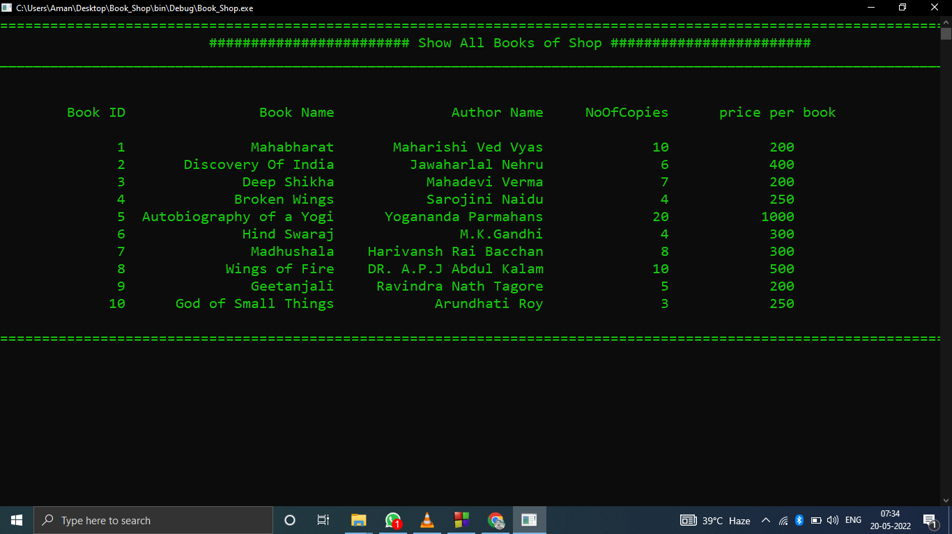
INTERFACE

Slide 27
Thank You

